Slide 1
First Order Logic

Slide 2
This Lecture
Last time we talked about propositional logic, a logic on simple statements.
This time we will talk about first order logic, a logic on quantified statements.
First order logic is much more expressive than propositional logic.
The topics on first order logic are:
Quantifiers
Negation
Multiple quantifiers
Arguments of quantified statements
(Optional) Important theorems, applications

Slide 3
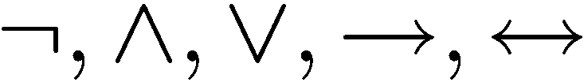
Limitation of Propositional Logic
Propositional logic – logic of simple statements
How to formulate Pythagoreans’ theorem using propositional logic?
b
c
a
How to formulate the statement that there are infinitely many primes?

Slide 4
Predicates
Predicates are propositions (i.e. statements) with variables
Example:
P (x,y) ::=
x + 2 = y
x = 1 and y = 3: P(1,3) is true
x = 1 and y = 4: P(1,4) is false
¬P(1,4) is true
When there is a variable, we need to specify what to put in the variables.
The domain of a variable is the set of all values
that may be substituted in place of the variable.

Slide 5


Set
To specify the domain, we often need the concept of a set.
Roughly speaking, a set is just a collection of objects.
R | Set of all real numbers
Z | Set of all integers
Q | Set of all rational numbers
Some examples
Given a set, the (only) important question is whether an element belongs to it.
means that x is an element of A (pronounce: x in A)
means that x is not an element of A (pronounce: x not in A)
Sets can be defined explicitly:
e.g. {1,2,4,8,16,32,…}, {CSC1130,CSC2110,…}

Slide 6

Truth Set
Sometimes it is inconvenient or impossible to define a set explicitly.
Sets can be defined by a predicate
Given a predicate P(x) where x has domain D, the truth set of P(x) is the set of all elements of D that make P(x) true.
e.g.
Let P(x) be “x is the square of a number”,
and the domain D of x is the set of positive integers.
Then the truth set is the set of all positive integers which are the square of a number.
e.g.
Let P(x) be “x is a prime number”,
and the domain D of x is the set of positive integers.
Then the truth set is the set of all positive integers which are prime numbers.

Slide 7



The Universal Quantifier
The universal quantifier
∀x
for ALL x
Example:
∀ x Z ∀ y Z, x + y = y + x.
c
Pythagorean’s theorem
b
a
Example:
This statement is true if the domain is Z, but not true if the domain is R.
The truth of a statement depends on the domain.

Slide 8
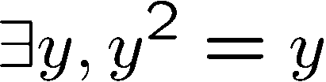
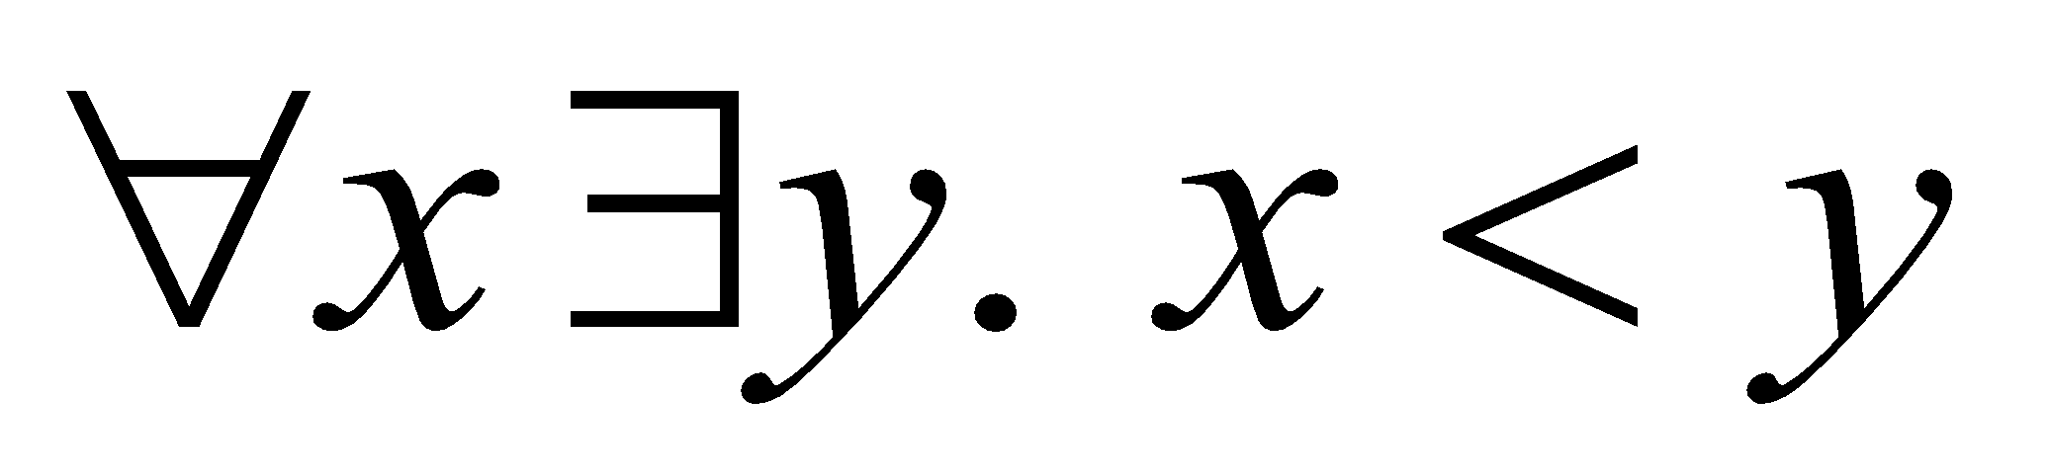
The Existential Quantifier
∃y
There EXISTS some y
e.g.
The truth of a statement depends on the domain.
Domain
Truth value
integers 
T
positive integers ⁺
T
negative integers ⁻
F
negative reals ⁻
T

Slide 9
Translating Mathematical Theorem
Fermat (1637): If an integer n is greater than 2,
then the equation a^{n} + b^{n} = c^{n} has no solutions in non-zero integers a, b, and c.
Andrew Wiles (1994)
http://en.wikipedia.org/wiki/Fermat's_last_theorem

Slide 10


Translating Mathematical Theorem
Goldbach’s conjecture: Every even number is the sum of two prime numbers.
Suppose we have a predicate prime(x) to determine if x is a prime number.
How to write prime(p)?

Slide 11
Quantifiers
Negation
Multiple quantifiers
Arguments of quantified statements
(Optional) Important theorems, applications

Slide 12
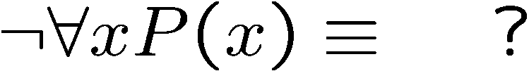
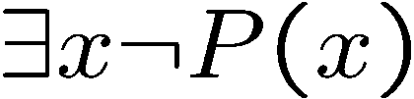


Negations of Quantified Statements
Everyone likes football.
What is the negation of this statement?
Not everyone likes football = There exists someone who doesn’t like football.
(generalized) DeMorgan’s Law
Say the domain has only three values.
The same idea can be used to prove it for any number of variables, by mathematical induction.

Slide 13
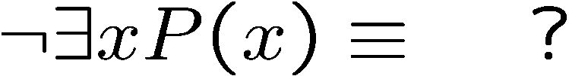
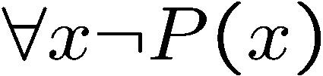

Negations of Quantified Statements
There is a plant that can fly.
What is the negation of this statement?
Not exists a plant that can fly = every plant cannot fly.
(generalized) DeMorgan’s Law
Say the domain has only three values.
The same idea can be used to prove it for any number of variables, by mathematical induction.

Slide 14
Quantifiers
Negation
Multiple quantifiers
Arguments of quantified statements
(Optional) Important theorems, applications

Slide 15
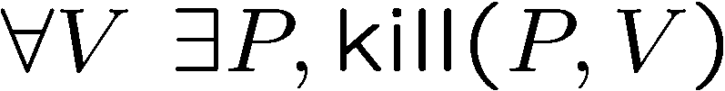
Order of Quantifiers
There is an anti-virus program killing every computer virus.
How to interpret this sentence?
For every computer virus, there is an anti-virus program that kills it.
For every attack, I have a defense:
against MYDOOM, use Defender
against ILOVEYOU, use Norton
against BABLAS, use Zonealarm …

Slide 16
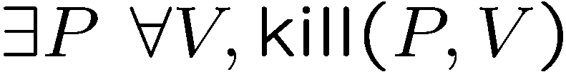
Order of Quantifiers
There is an anti-virus program killing every computer virus.
How to interpret this sentence?
There is one single anti-virus program that kills all computer viruses.
I have one defense good against every attack.
Example: P is CSE-antivirus,
protects against ALL viruses
That’s much better!
Order of quantifiers is very important!

Slide 17
Order of Quantifiers
Let’s say we have an array A of size 6x6.
1
 | 1 | 1 |  | 1
 |  | 1
 |  | 1 |  | 1
 |  |  | 1
 |  | 1
Then this table satisfies the statement.

Slide 18
Order of Quantifiers
Let’s say we have an array A of size 6x6.
1
 | 1 | 1 |  | 1
 |  | 1
 |  | 1 |  | 1
 |  |  | 1
 |  | 1
But if the order of the quantifiers are changes,
then this table no longer satisfies the new statement.

Slide 19
Order of Quantifiers
Let’s say we have an array A of size 6x6.
1 | 1 | 1 | 1 | 1 | 1
To satisfy the new statement, there must be a row with all ones.

Slide 20
Questions
Are these statements equivalent?
Are these statements equivalent?
Yes, in general, you can change the order of two “foralls”,
and you can change the order of two “exists”.

Slide 21
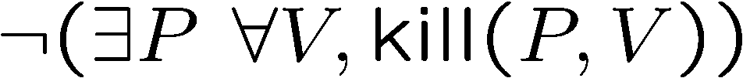
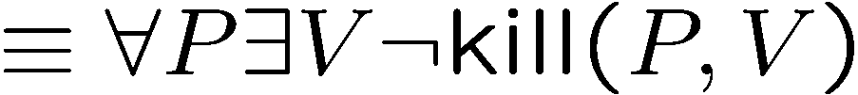
More Negations
There is an anti-virus program killing every computer virus.
What is the negation of this sentence?
For every program, there is some virus that it can not kill.

Slide 22
Exercises
There is a smallest positive integer.
There is no smallest positive real number.
There are infinitely many prime numbers.

Slide 23
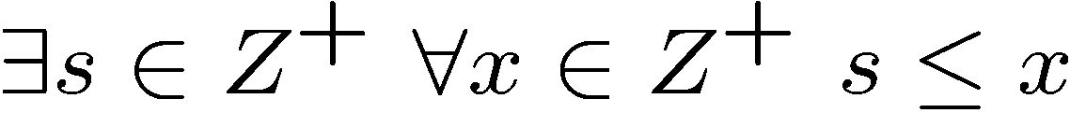

Exercises
There is a smallest positive integer.
There is no smallest positive real number.
There are infinitely many prime numbers.

Slide 24
Quantifiers
Negation
Multiple quantifiers
Arguments of quantified statements
(Optional) Important theorems, applications

Slide 25







Arguments with Quantified Statements
Universal instantiation:
Universal modus ponens:
Universal modus tollens:

Slide 26
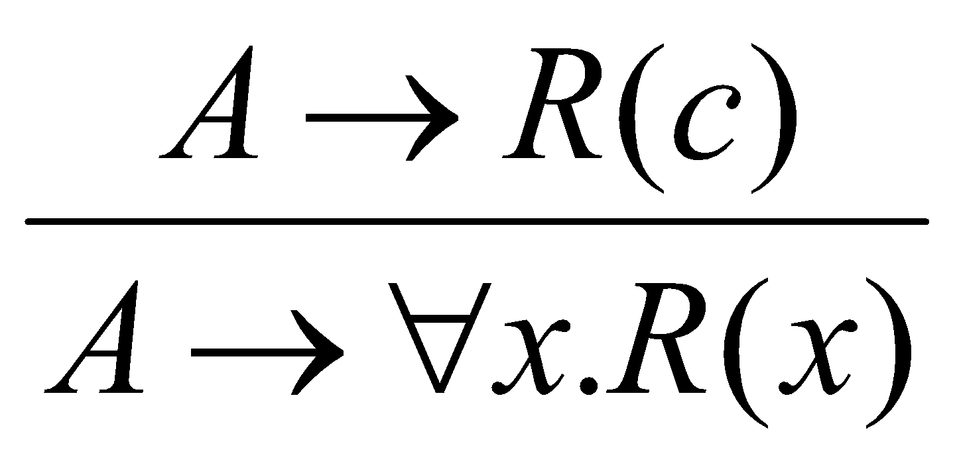
Universal Generalization
valid rule
providing c is independent of A
Informally, if we could prove that R(c) is true for an arbitrary c
(in a sense, c is a “variable”), then we could prove the for all statement.
e.g. given any number c, 2c is an even number
=> for all x, 2x is an even number.
Remark: Universal generalization is often difficult to prove, we will
introduce mathematical induction to prove the validity of for all statements.

Slide 27
Quantifiers
Negation
Multiple quantifiers
Arguments of quantified statements
Important theorems, applications

Slide 28
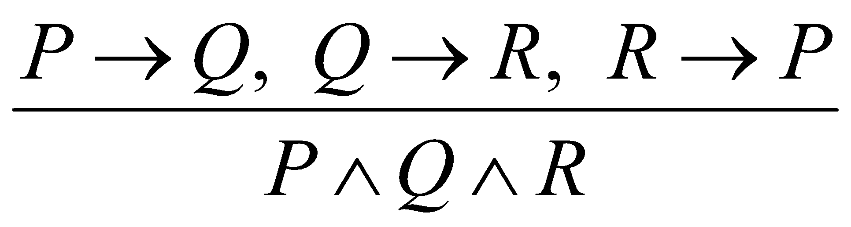
Mathematical Proof
We prove mathematical statements by using logic.
not valid
To prove something is true, we need to assume some axioms!
This was invented by Euclid in 300 BC,
who began with 5 assumptions about geometry,
and derived many theorems as logical consequences.
http://en.wikipedia.org/wiki/Euclidean_geometry

Slide 29
Ideal Mathematical World
What do we expect from a logic system?
What we prove is true. (soundness)
What is true can be proven. (completeness)
Hilbert’s program
To resolve foundational crisis of mathematics (e.g. paradoxes)
Find a finite, complete set of axioms,
and provide a proof that these axioms were consistent.
http://en.wikipedia.org/wiki/Hilbert’s_program

Slide 30
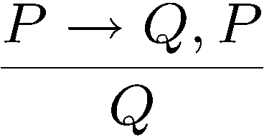
Power of Logic
Good news: Gödel's Completeness Theorem
Only need to know a few axioms & rules, to prove all validities.
That is, starting from a few propositional & simple predicate validities, every valid first order logic formula can be proved using just universal generalization and modus ponens repeatedly!
modus ponens

Slide 31
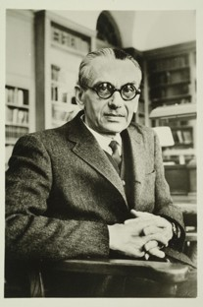
Limits of Logic (Optional)
Gödel's Incompleteness Theorem for Arithmetic
For any “reasonable” theory that proves basic arithmetic truth, an arithmetic statement that is true, but not provable in the theory, can be constructed.
(very very brief) proof idea:
Any theory “expressive” enough can express the sentence
“This sentence is not provable.”
If this is provable, then the theory is inconsistent.
So it is not provable.

Slide 32
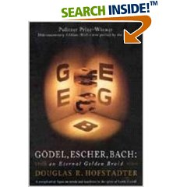
Limits of Logic (Optional)
Gödel's Second Incompleteness Theorem for Arithmetic
For any “reasonable” theory that proves basic arithemetic truth, it cannot prove its consistency.
No hope to find a complete and consistent set of axioms?!
An excellent project topic:
http://en.wikipedia.org/wiki/G%C3%B6del%27s_incompleteness_theorems

Slide 33
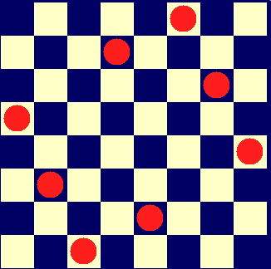
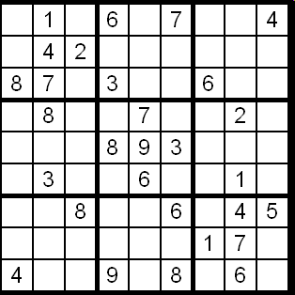
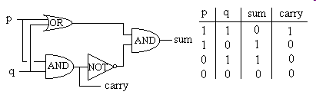
Applications of Logic
Logic programming
Database
Digital circuit
solve problems by logic
making queries, data mining

Slide 34
Summary
This finishes the introduction to logic, half of the first part.
In the other half we will use logic to do mathematical proofs.
At this point, you should be able to:
Express (quantified) statements using logic formula
Use simple logic rules (e.g. DeMorgan, contrapositive, etc)
Fluent with arguments and logical equivalence

